Slide 1
Personal Development Plan
Dr. Salima Ahsan Tejani
Professional practices and social Ethics.

Slide 2
2. Highlight areas of self-knowledge you need to focus on
You need to focus on the most important areas in your life. Since these change from time to time you need to adjust your list of them accordingly. Then you need to work at bringing your self-knowledge of these areas up to speed.
Exercise:
a. Reflect on the key areas in your life at present.
b. Select some of these to think more clearly about.
For example, the seven I choose are: 1. Strengths; 2. Weaknesses that inhibit my use of strengths; 3. Relationships; 4. Health; 5. Personal Development; 6. Happiness; 7. Work/Life Balance.

Slide 3
3. How accurate is your self-knowledge?
We distort our self-knowledge. We do so to show ourselves in the best possible light. Which leads us to think more highly of ourselves than other people do. We all distort how we think about ourselves in this way. And since our need for the good opinion of others makes us wary of criticism we edit out comments that could give us a more balanced view.
We need to become more aware of how well we think of ourselves. Our first step should be to accept how we distort our abilities. Then we should question our judgement and sense of certainty. We should also check the accuracy of our information. And we should consult people whose judgement we can rely on.

Slide 4
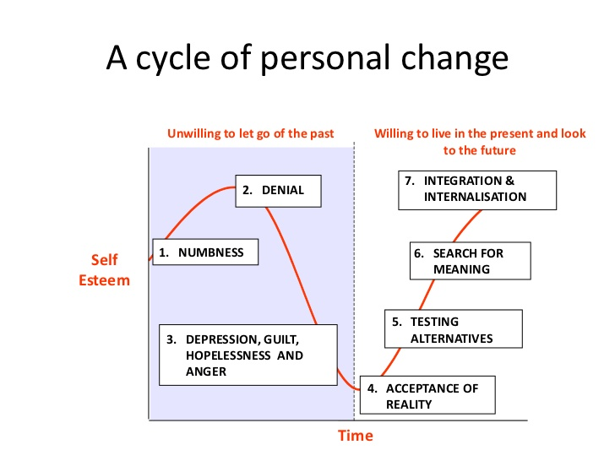
A cycle of Personal Change

Slide 5
Exercise:
a. Learn to accept the short-comings of our self-knowledge.
b. Always seek other people’s opinions.
c. Find new and more effective ways of doing this.
4. Get other people’s views

Slide 6
4. Get other people’s views
Well formed self-knowledge reflects how other people see us. So it makes sense to consult people we work with and close to. As does checking things out with bosses, spouses, and major clients. It also helps to consider how organizations we are members of view these issues.
Exercise:
a. Reflect on how well you consult each of the above three sources at present.
b. Identify better ways of doing so in the future.

Slide 7
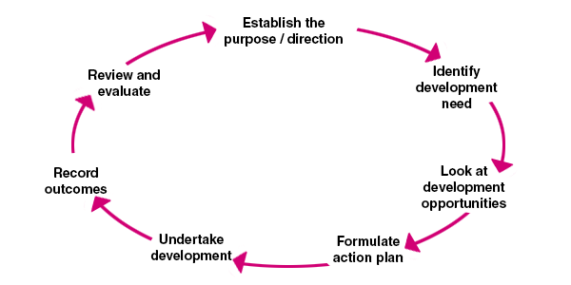
Self Development Plan.

Slide 8
Read article
A Self-Knowledge Reality Check
by Michael J Costello • February 8, 2012 • Organising Your Life

